Slide 1


Lecture 6:
Support Vector Machines and PCA
McGill Artificial
Intelligence Society

Slide 2
Today’s Agenda
Support Vector Machines (SVMs)
Dimensionality Reduction Motivation
Quick Review on Eigenvectors and Eigenvalues
Principal Component Analysis (PCA)
PCA Demo

Slide 3
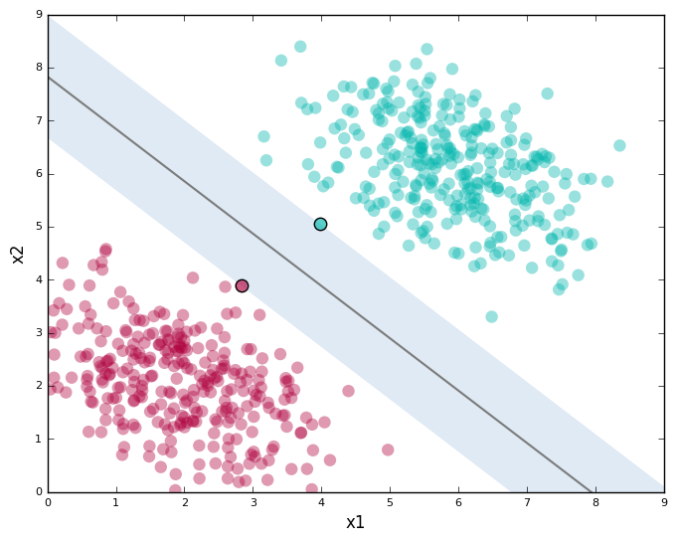
Support Vector Machines (SVM)
Fundamental ML Algorithm:
generally used for classification tasks
Simple, inexpensive algorithm with relatively good performance
Image Courtesy
Notes:
In this example, since we’re data scientists that stick to good practices, before deciding on what ML model to use, we visualize our original dataset, and we can see that using x1^2, x2^2 instead of the original x1 and x2 features might help with classification. (Slide)

Slide 4
Support Vector Machines (SVM)
Objective: SVMs attempt to find the optimal hyperplane in the n-dimension space, n being the number of input features that can best distinguish between different classes (labels)
Image Courtesy
Notes:
In this example, since we’re data scientists that stick to good practices, before deciding on what ML model to use, we visualize our original dataset, and we can see that using x1^2, x2^2 instead of the original x1 and x2 features might help with classification. (Slide)

Slide 5
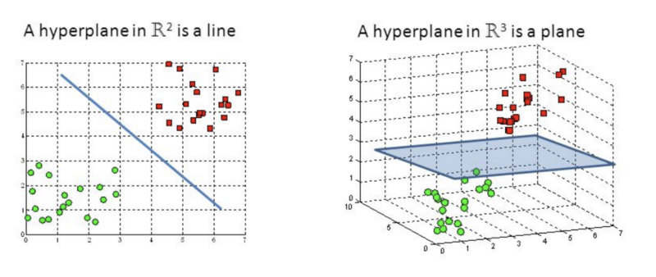
Optimal Hyperplane
Hyperplanes are the decision boundaries that help classify the data points.
Classification of new instances depends on which side of the hyperplane the data point falls on!
Image Courtesy
Notes:
In this example, since we’re data scientists that stick to good practices, before deciding on what ML model to use, we visualize our original dataset, and we can see that using x1^2, x2^2 instead of the original x1 and x2 features might help with classification. (Slide)

Slide 6
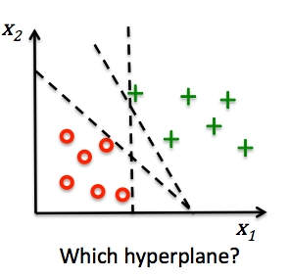
Optimal Hyperplane
Infinitely many hyperplanes to choose from, what is the best one?
Notes:
In this example, since we’re data scientists that stick to good practices, before deciding on what ML model to use, we visualize our original dataset, and we can see that using x1^2, x2^2 instead of the original x1 and x2 features might help with classification. (Slide)

Slide 7
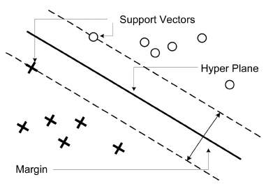

Optimal Margins
The optimal hyperplane is the one that maximizes the margin between the closest instances of both classes
Image Courtesy
Notes:
– I.e. the width of the “strip” around the decision boundary that contains
no training examples

Slide 8
Support Vectors
Hyperplane defined by the location of the support vectors.
Support Vector: points from different classes that are the closest to each other (points lying on the edge of the margin), which define the orientation and the position of the optimal hyperplane
Image Courtesy
Notes:
– I.e. the width of the “strip” around the decision boundary that contains
no training examples

Slide 9
Support Vectors
Deleting a support vector will change the direction/position of the hyperplane.
For the optimal hyperplane, the margin is twice the distance from the plane to nearest training example.
Image Courtesy
Notes:
– I.e. the width of the “strip” around the decision boundary that contains
no training examples

Slide 10
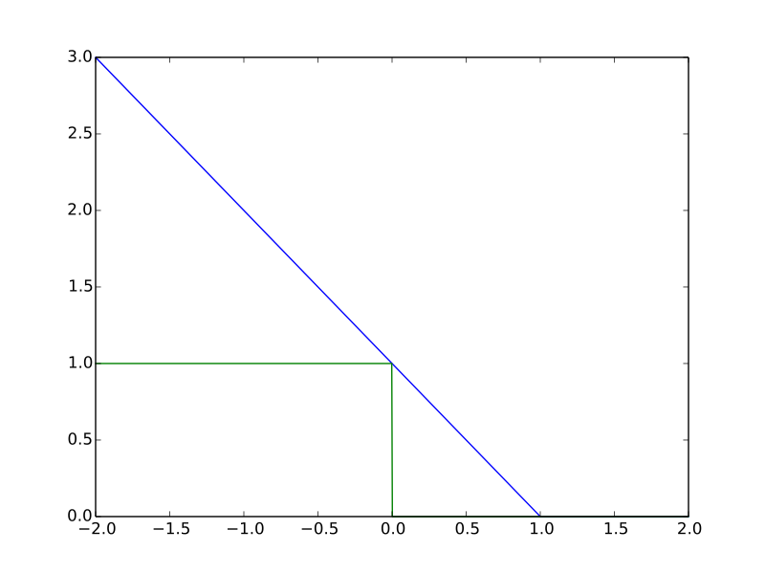

Support Vector Machines
Weight updated via gradient descent, as linear decision boundary takes on the same form of a linear model in linear regression
Loss Function: Hinge Loss
t is class label (+1, -1)
Error is 0 when correct class label and classified point lies outside of error margin.
Image Courtesy

Slide 11
Support Vector Machines
Solve convex optimization problem using quadratic programming (Not covered)
Simple, easy to interpret algorithm
What about non-linearly separable feature spaces??
Image Courtesy

Slide 12
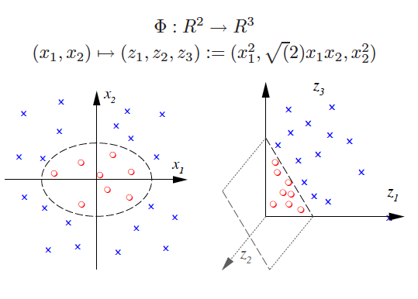
Kernel Functions
Kernel functions do the same thing as transforming points from one feature space to another.

Slide 13
Features, so many of them...
Images and video data
Gene expression data
NLP tasks with very large vocabularies
Notes:
Now that we’ve talked about increasing the number of features using expansions, we consider the case where we have samples with a very high number of features!! Here are a few examples of applications with a higher feature space…
(Ask random member: So, now we’re going to talk about dimensionality reduction, that is, we want to reduce the dimensions of our inputs, e.g. from 1000 x 1000 images to 64 x 64 images. Why would we do that? Are there any benefits?)
(Slide)

Slide 14
Dimensionality Reduction
Dimensionality reduction is an unsupervised machine learning task!
Given dataset X with m features, we wish to learn X’ with m’ features, where m’ << m
PROS
Reduces variance of the model
Reduce model complexity and training time
Find the most relevant features (or combinations of features)
Data compression
CONS
Loss of interpretability
Some algorithms oversimplify assumptions on data structure
Notes:
With thousands to even millions of low level features: we wish to select the most relevant ones to build better, faster, and more interpretable learning machines.
I.e. given a dataset X of size n x m, we wish to learn X’ of size n x m’, where m’ << m (for all you visual learners: draw matrix on board)
(Read pros)
Naive approach: remove features to reduce our feature matrix to a lower dimension (Ask: what’s the problem with that)
(Answer: loss of information)
Hence, we begin by taking a look at a dimensionality reduction technique called PCA

Slide 15

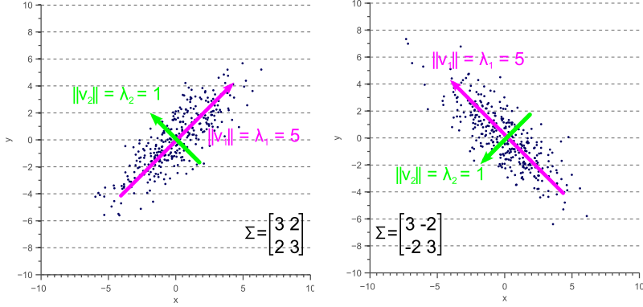
Principal Component Analysis (PCA)
Goal: Project data into lower dimension subspace, given matrix X with m features, we wish to learn X’ with m’ features, where m’ << m
How do we ensure the preservation of important information?
Criteria - Projection onto linear subspace must maximize variance described
Notes:
So PCA is a technique for dimensionality reduction via linear projections. This involves computing eigenvectors and eigenvalues of the space, as shown by the equation written on the slide. We’re just trying to project our data onto a lower subspace, while retaining important information. So we can’t just choose any subspace, can we? So the criteria for choosing the best subspace, is to project our data onto a linear subspace that maximizes variance.
So what does this look like? Observe this 2D data. If we wished to maximize variance along a single line, we see that if we project onto a subspace described here by the purple line, we’d maximize variance. (Slide)
(Slide)

Slide 16
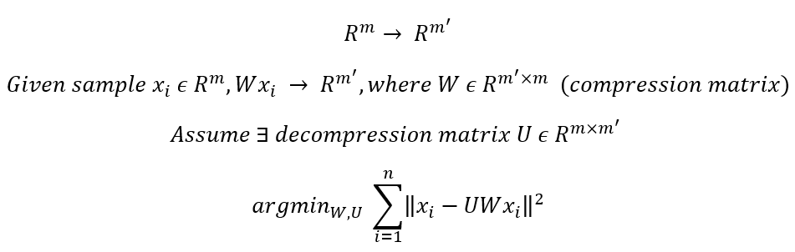
Principal Component Analysis (PCA)
Goal: Project data into lower dimension subspace, given matrix X with m features, we wish to learn X’ with m’ features, where m’ << m
Select the projection dimension m’ using cross-validation
Notes:
To no one’s surprise, when we’re dealing with matrices and we’re talking about projecting our feature matrix to a lower dimension, we’re dealing with linear transformations.
So let’s say that each sample xi has m features, so we say it’s in dimension Rm. We’re looking for a compression matrix W, such that Wxi is in Rm’. (Questions so far)
Now, we assume that there’s a decompression matrix U, that brings a vector in Rm’ back to Rm.
Now, we’re able to phrase an optimization problem that seems all too familiar. We’re looking to minimize our residual sum of squares, but this time we’re trying to learn a compression matrix W.
So this problem is a known one, and does have a closed-form solution! (Slide)

Slide 17

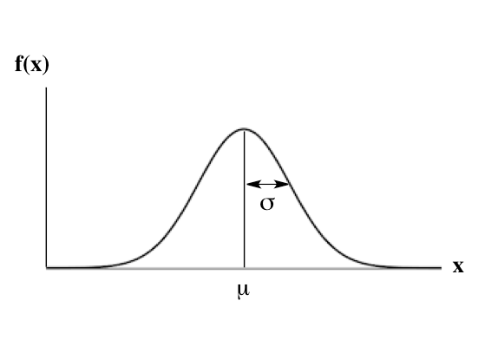

Step 1 - Standardization
Typically, we center the examples by subtracting the mean
We can also then divide the value by its standard deviation
This process is called standardization
Notes:
Recall that we’re trying to project to a subspace where we maximize variance. And remember that variance, is always defined relative to the mean.
So what we do is we “clean” up our data, by defining X_bar. X_bar is simply X minus its mean mu(X). It’s always easier to learn by example, so let’s look at equations with numbers (Slide)

Slide 18
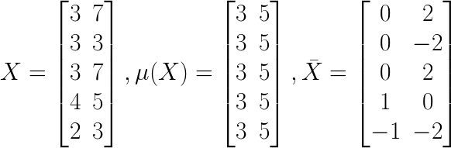
Numerical Example
Notes:
So in this case, we have a data matrix X with n = 5, m =2. Ok so now we’ve defined our mean centered feature matrix Xbar, what can we do to compute our principal components?
As we saw in the previous slides, the covariance matrix defines both the spread (variance), and the orientation (covariance) of our data. So, if we would like to represent the covariance matrix with a vector and its magnitude, we should simply try to find the vector that points into the direction of the largest spread of the data, and whose magnitude equals the spread (variance) in this direction. So it turns out that this problem can simply be equated to computing the eigenvectors of our covariance matrix sigma (Slide)

Slide 19
Step 1 - Standardization
Why?
PCA is quite sensitive to different variances of the initial variables
→ if there are large differences between the ranges of initial variables, those variables with larger ranges will dominate over those with small ranges
Ex: a variable that ranges between 0 and 100 will dominate over a variable that ranges between 0 and 1), which will lead to biased results
Notes:
Recall that we’re trying to project to a subspace where we maximize variance. And remember that variance, is always defined relative to the mean.
So what we do is we “clean” up our data, by defining X_bar. X_bar is simply X minus its mean mu(X). It’s always easier to learn by example, so let’s look at equations with numbers (Slide)

Slide 20

Step 2 - Compute the Covariance Matrix
For a feature space of dimension m, we define the covariance matrix to be a m x m matrix, where the entries of the matrix are formed by the covariance of all possible pairs of features
E.g., for a 3-dimensional data set with 3 variables x, y, and z, the covariance matrix is a 3×3 matrix of this from:
Notes:
The closed form solution has to do with what we call our covariance matrix, notated as sigma. We’ll be talking about the eigenvectors and eigenvalues of this matrix.
So what is this covariance matrix? Let’s take a step back and talk about variance. Variance, as we saw in the Gaussian distribution, was related to standard deviation, which provides a measure of how much the data is “spread” across the feature space. But what if we want to explain multiple variances, in 3D? Or just in general, in higher dimensions?
Consider the 2D space in the top-left corner of the slide.
For this data, we could calculate the variance in the x-direction and the variance in the y-direction. However, the horizontal spread and the vertical spread of the data does not explain the clear diagonal correlation. We can clearly see that on average, if the x-value of a data point increases, then also the y-value increases, resulting in a positive correlation. This correlation can be captured by extending the notion of variance to what is called the ‘covariance’ of the data.
For 2D data, we thus obtain sigma(x,x), sigma(y,y), sigma(x,y) and sigma(y,x). These four values can be summarized in a matrix, called the covariance matrix. As expected, a N x N covariance matrix captures the spread of N-dimensional data.
(Example of top left covariance matrix) Let’s take a read at the top left covariance matrix. (Slide)

Slide 21
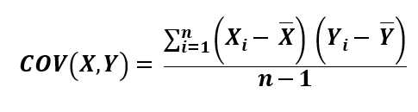
What Does Covariance Tell Us?
The numerical values give some information, but what’s important is the sign of the covariance between two variables!
Positive: the two variables increase or decrease together → correlated
Negative: One increases when the other decreases → inversely correlated
TLDR: the covariance matrix is just a table summarizing the correlations between all possible pairs of features
Notes:
The closed form solution has to do with what we call our covariance matrix, notated as sigma. We’ll be talking about the eigenvectors and eigenvalues of this matrix.
So what is this covariance matrix? Let’s take a step back and talk about variance. Variance, as we saw in the Gaussian distribution, was related to standard deviation, which provides a measure of how much the data is “spread” across the feature space. But what if we want to explain multiple variances, in 3D? Or just in general, in higher dimensions?
Consider the 2D space in the top-left corner of the slide.
For this data, we could calculate the variance in the x-direction and the variance in the y-direction. However, the horizontal spread and the vertical spread of the data does not explain the clear diagonal correlation. We can clearly see that on average, if the x-value of a data point increases, then also the y-value increases, resulting in a positive correlation. This correlation can be captured by extending the notion of variance to what is called the ‘covariance’ of the data.
For 2D data, we thus obtain sigma(x,x), sigma(y,y), sigma(x,y) and sigma(y,x). These four values can be summarized in a matrix, called the covariance matrix. As expected, a N x N covariance matrix captures the spread of N-dimensional data.
(Example of top left covariance matrix) Let’s take a read at the top left covariance matrix. (Slide)

Slide 22
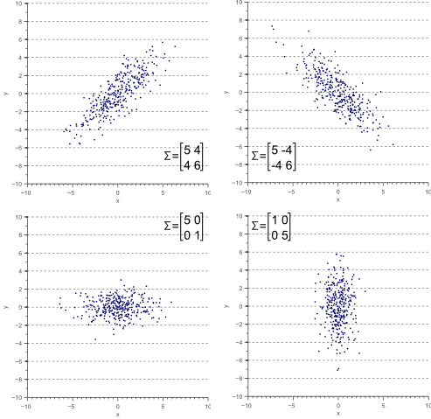
PCA - The Covariance Matrix
Image Credits
Notes:
The closed form solution has to do with what we call our covariance matrix, notated as sigma. We’ll be talking about the eigenvectors and eigenvalues of this matrix.
So what is this covariance matrix? Let’s take a step back and talk about variance. Variance, as we saw in the Gaussian distribution, was related to standard deviation, which provides a measure of how much the data is “spread” across the feature space. But what if we want to explain multiple variances, in 3D? Or just in general, in higher dimensions?
Consider the 2D space in the top-left corner of the slide.
For this data, we could calculate the variance in the x-direction and the variance in the y-direction. However, the horizontal spread and the vertical spread of the data does not explain the clear diagonal correlation. We can clearly see that on average, if the x-value of a data point increases, then also the y-value increases, resulting in a positive correlation. This correlation can be captured by extending the notion of variance to what is called the ‘covariance’ of the data.
For 2D data, we thus obtain sigma(x,x), sigma(y,y), sigma(x,y) and sigma(y,x). These four values can be summarized in a matrix, called the covariance matrix. As expected, a N x N covariance matrix captures the spread of N-dimensional data.
(Example of top left covariance matrix) Let’s take a read at the top left covariance matrix. (Slide)

Slide 23
Step 3 - Compute the eigenvectors/eigenvalues
We now compute the eigenvectors and eigenvalues of the covariance matrix, which will help us find the principal components
What are the principal components?
→ new variables that are constructed as linear combinations of initial variables.
Combinations built such that the new variables are uncorrelated and most of the information within the initial variables is squeezed into the first components

Slide 24
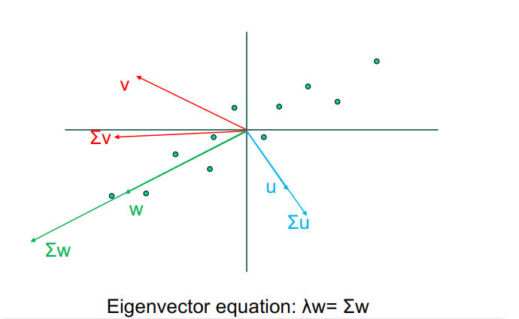
Principal Component Analysis (PCA)
Notes:
So, just a visualization! (Slide)

Slide 25
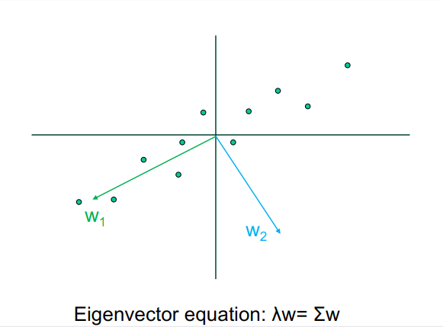
Principal Component Analysis (PCA)

Slide 26
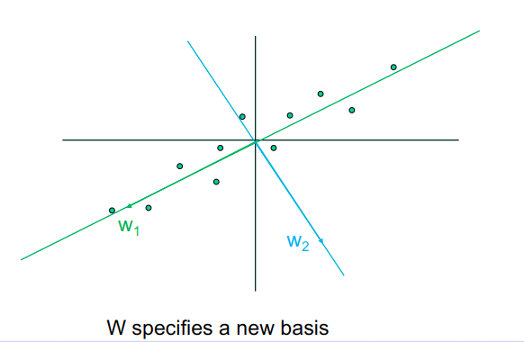
Principal Component Analysis (PCA)

Slide 27
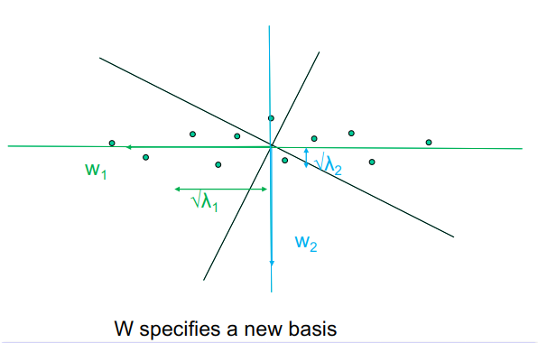
Principal Component Analysis (PCA)
Notes:
Before getting into the math behind it, let’s take a quick look at PCA does visually! (Slide)

Slide 28
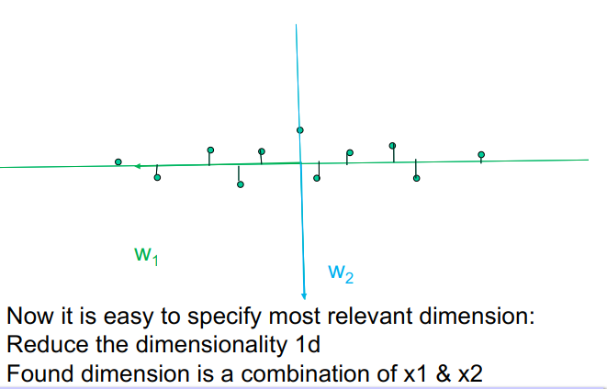
Principal Component Analysis (PCA)
Notes:
Before getting into the math behind it, let’s take a quick look at PCA does visually! (Slide)

Slide 29
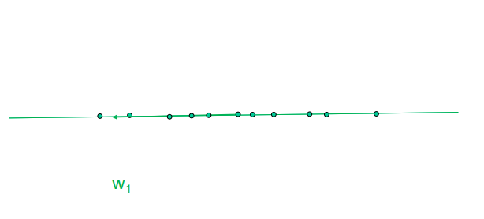
Principal Component Analysis (PCA)
Notes:
Before getting into the math behind it, let’s take a quick look at PCA does visually! (Slide)

Slide 30
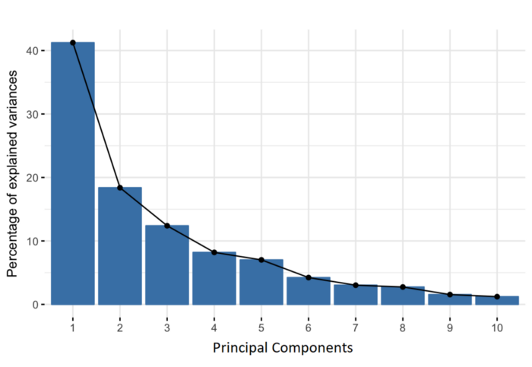
PCA Summary
In summary, to compute m’ principal components:
Calculate covariance matrix X^{T}X, then compute the W matrix (with columns being the eigenvectors of covariance matrix)
Take m’ most relevant components (determined via cross-validation)
Notes:
Before getting into the math behind it, let’s take a quick look at PCA does visually! (Slide)

Slide 31
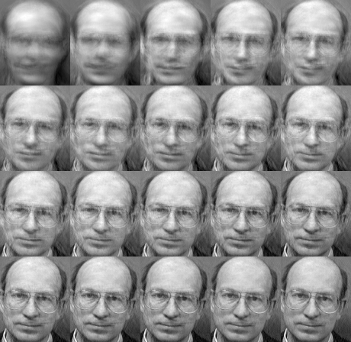
PCA applications - Eigenfaces
Notes:
NOTE: mention assignment PCA preprocessing on adult dataset

Slide 32
Homework Assignment
Support Vector Machines and PCA Exploration.
Assignment6-SVMsAndPCA.ipynb

Slide 33
Thanks!
Any questions?
McGill Artificial
Intelligence Society

